Slide 1
CSE 3002- programming in java unit I objects and classes
Dr. R. Manikandan
Assistant professor (senior grade)
Vit bhopal university

Slide 2
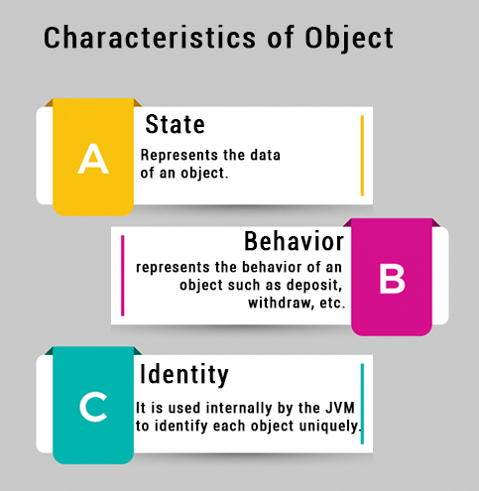
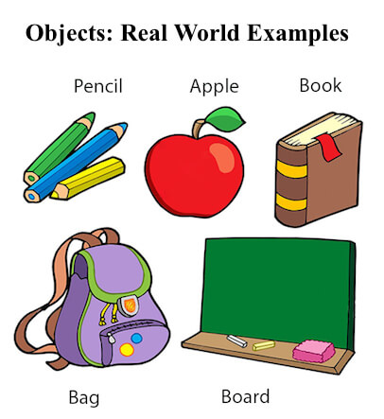
Basics of JAVA: Objects and Classes
Object :
An object is a real-world / runtime entity
An entity that has state and behaviour is known as an object e.g. chair, bike, marker, pen, table, car etc. It can be physical or logical (tangible and intangible). The example of an intangible object is the banking system.

Slide 3
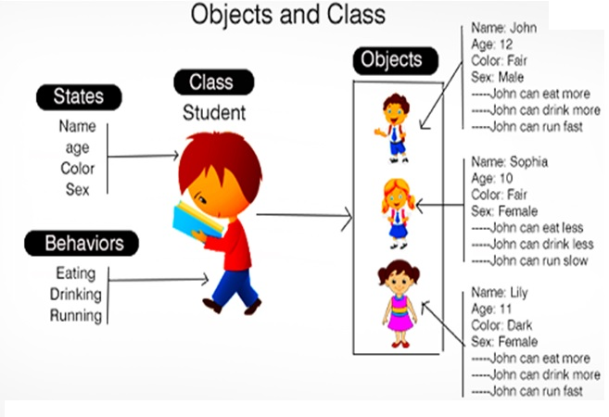
Basics of JAVA: Objects and Classes
Class:
A class is a group of objects which have common properties. It is a template or blueprint from which objects are created. It is a logical entity. It can't be physical.

Slide 4
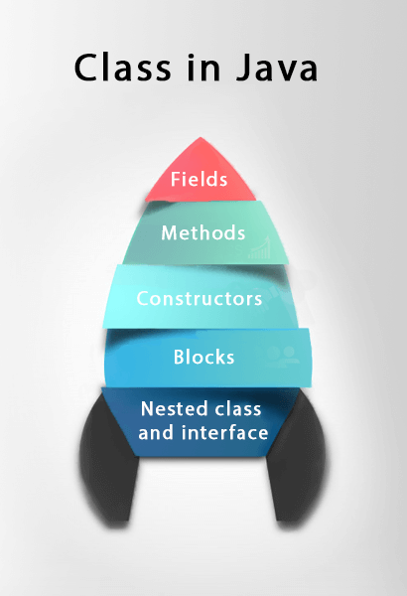
Basics of JAVA: Objects and Classes
Class:
Syntax:
Access Modifiers class <class_name>{
field;
method;
}
Instance variable
A variable which is created inside the class but outside the method is known as an instance variable.
Instance variable doesn't get memory at compile time.
It gets memory at runtime when an object or instance is created. That is why it is known as an instance variable.

Slide 5
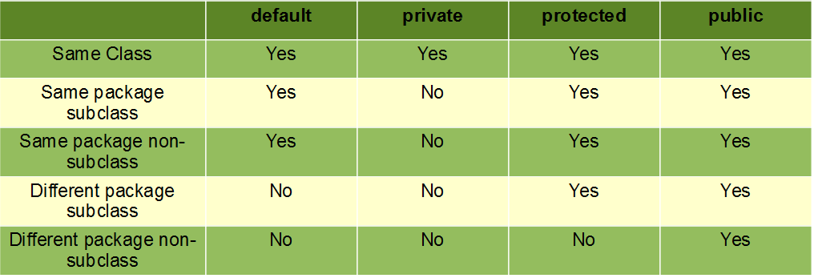
Access Modifiers
Access modifiers in Java helps to restrict the scope of a class, constructor , variable , method or data member. There are four types of access modifiers available in java:
Default – No keyword required
Private, Protected, Public
For classes and interface, you can use either public or default
For attributes, methods and constructors, you can use the one of the following: Private, Protected, default, Public

Slide 6
Properties and Behaviors of Customer Class
Customer class
name
address
billing info
age
customer number
order number
requestDiscount()
setAddress()
shop()
displayCustomer()
Class name
Fields
Methods
Behaviors:
Shop
Set Address
Add item to cart
Ask for a discount
Display customer details
Properties:
Name
Address
Age
Order number
Customer number
Notes:
Think of some properties and behaviors that are in the Customer class of Duke’s Choice. Think about how you would write this information as a Java class.

Slide 7
The Components of a Class
Class declaration
1 public class Customer {
2 public String name = "Junior Duke";
3 public int custID = 1205;
4 public String address;
5 public int orderNum;
6 public int age;
7
8 public void displayCustomer(){
9 System.out.println("Customer: "+name);
}
11 }
Fields
(Properties)
(Attributes)
Methods
(Behaviors)
Is possible to define two public classes in one file in java?
No. As per java language specification, there can be only one public class in a file (.java) and file name should be same as public class name. If you want class B accessible in other places, you may create a separate B.java file and move your Class B code to that file.
Notes:
In the previous slide, you have identified some properties and behaviors that might be in the Customer class. This code example demonstrates how the properties and methods are created in Java. The basic components of a Java class are:
The class declaration. Notice that the entire class is surrounded by braces.
Fields of the class. These represent the properties or attributes of the class.
Methods of the class. These represent the behaviors or operations. Here you see just one method, displayCustomer.
Note: In the code example above, the word “public” is a modifier, and you learn about modifiers later in the course.

Slide 8
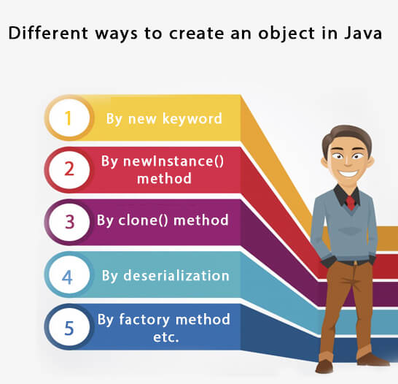
Basics of JAVA: Object Creation
When an object of a class is created, the class is said to be instantiated. All the instances share the attributes and the behaviour of the class. But the values of those attributes, i.e. the state are unique for each object. A single class may have any number of instances.

Slide 9
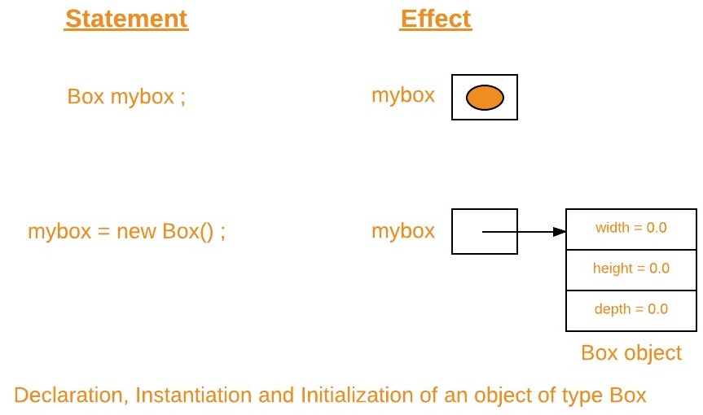
Object Creation using new keyword
variable becomes a reference to that object.
The new keyword creates (instantiates) a new instance.
The syntax is:
<class name> variable = new <class name>()
Example 1:
class Box
{
double width, height, depth;
}

Slide 10
Object Creation using new keyword
Example 2:
1 public class Customer {
2 public String name = "Junior Duke";
3 public int custID = 1205;
4 public String address;
5 public int orderNum;
6 public int age;
7
8 public void displayCustomer(){
9 System.out.println("Customer: "+name);
}
public static void main(String[] args){
Customer customer01 = new Customer(); //Declare and instantiate
Customer customer02; //Declare the reference
customer02 = new Customer(); //Then instantiate
}
}
Notes:
In the previous slide, you have identified some properties and behaviors that might be in the Customer class. This code example demonstrates how the properties and methods are created in Java. The basic components of a Java class are:
The class declaration. Notice that the entire class is surrounded by braces.
Fields of the class. These represent the properties or attributes of the class.
Methods of the class. These represent the behaviors or operations. Here you see just one method, displayCustomer.
Note: In the code example above, the word “public” is a modifier, and you learn about modifiers later in the course.

Slide 11
The Dot (.) Operator
Follow the reference variable with a dot operator (.) to access the fields and methods of an object.
public static void main(String[] args){
Customer customer01 = new Customer();
//Accessing fields
System.out.println(customer01.name);
customer01.age = 40;
//Calling methods
customer01.requestDiscount();
customer01.displayCustomer();
}
}
Customer class
name
address
billing info
age
customer number
order number
requestDiscount()
setAddress()
shop()
displayCustomer()

Slide 12
Creating and Using Methods
Advantages of Using Methods
Methods:
Are reusable
Make programs shorter and more readable
Make development and maintenance quicker
Allow separate objects to communicate and to distribute the work performed by the program
The void keyword indicates that the method does not return a value.
Empty parentheses indicate that no arguments are passed to the method.
1 public void display () {
2 System.out.println("Shirt description:" + description);
3 System.out.println("Color Code: " + colorCode);
4 System.out.println("Shirt price: " + price);
5 } // end of display method

Slide 13

Calling a Method from a Different Class
1 public class ShoppingCart {
2 public static void main (String[] args) {
3 Shirt myShirt = new Shirt();
4 myShirt.display();
5 }
6 }
Method
Dot operator
Reference variable
Caller
Worker
Notes:
In the example in this slide, display is called by typing the reference variable for the object, the dot operator, followed by the method to be called. The default values, as set in the Shirt constructor, are displayed.

Slide 14
Method Arguments and Parameters
An argument is a value that is passed during a method call:
Calculator calc = new Calculator();
double denominator = 2.0
calc.calculate(3, denominator); /should print 1.5
A parameter is a variable defined in the method declaration:
public void calculate(int x, double y){
System.out.println(x/y);
}
Arguments
3
2.0
Parameters
Notes:
Note: A value passed into the method when it is called is called an argument, whereas a variable that is defined in the method declaration is called a method parameter.
In this example, 3 and 2.0 are passed to be the values of x and y within the calculate method.

Slide 15
Method Parameter Examples
Methods may have any number or type of parameters:
public void calculate0(){
System.out.println("No parameters");
}
public void calculate1(int x){
System.out.println(x/2.0);
}
public void calculate2(int x, double y){
System.out.println(x/y);
}
public void calculate3(int x, double y, int z){
System.out.println(x/y +z);
}
Notes:
Methods can take any number of parameters and use these values within the method code block.

Slide 16
Method Return Types Examples
Methods must return data that matches their return type:
public void printString(){
System.out.println("Hello");
}
public String returnString(){
return("Hello");
}
public int sum(int x, int y){
return(x + y);
}
public boolean isGreater(int x, int y){
return(x > y);
}
Void methods cannot
return values in Java.
Notes:
Void methods and constructors should not have a return statement. Void methods are incapable of returning a value in Java. The type of value a method returns must match the return type you declare. For instance, a boolean type method must return a boolean. A String type method must return a String.

Slide 17
Passing Arguments and Returning Values
1
2
Value passed from caller method to worker method
Value received by worker method
Object
method
1
2
3
4
5
6
7
1
2
3
4
3
Value returned to caller method

Slide 18
this keyword
Keyword this is a reference variable in Java that refers to the current object.
The various usages of 'THIS' keyword in Java are as follows:
It can be used to refer instance variable of current class
It can be used to invoke or initiate current class constructor
It can be passed as an argument in the method call
It can be passed as argument in the constructor call
It can be used to return the current class instance
Example: CustomerMain.java

Slide 19
Exercise
In this exercise, you create the Item class and declare public fields for ID (int), descr (String), quantity (int), and price (double) and introduce the two member function as like below:
void insertRecord(int, String, int, double)
void display()
You create the ShoppingCart class as a main class and create two objects of Item class and try to access attributes and member function of Item class in the following environment:
Both Item and ShoppingCart as a same file i.e. ShoppingCart.java
Both Item and ShoppingCart as a separate file i.e. Item.java and ShoppingCart.java resides in same directory
Both Item and ShoppingCart as a separate file i.e. Item.java and ShoppingCart.java resides in different directory

Slide 20
Method Overloading
Overloaded methods:
Have the same name
Have different signatures
The number of parameters, The types of parameters and The order of parameters
May have different functionality or similar functionality
Are widely used in the foundation classes
Example: TestOverloading1.java, TestOverloading2.java, TestOverloading3.java,
Method | Use
void println() | Terminates the current line by writing the line separator string
void println(boolean x) | Prints a boolean value and then terminates the line
void println(char x) | Prints a character and then terminates the line
void println(char[] x) | Prints an array of characters and then terminates the line

Slide 21
Method Overloading
Can we overload java main() method?
Yes. Example: MainOverload.java
Why Method Overloading is not possible by changing the return type of method only?
Because of ambiguity
class Adder{
static int add(int a,int b){return a+b;}
static double add(int a,int b){return a+b;}
}
class TestOverloading3{
public static void main(String[] args){
System.out.println(Adder.add(11,11));//ambiguity
}
}

Slide 22
Constructors
A constructor in Java is a special method that is used to initialize objects.
The constructor is called when an object of a class is created. It can be used to set initial values for object attributes
Every time an object is created using new() keyword, at least one constructor is called.
Types
Default Constructor
Compiler defined or User defined
A constructor that has no parameter is known as default constructor. If user don’t define a constructor in a class, then compiler creates default constructor(with no arguments) for the class
Parameterized Constructor
A constructor that has parameters is known as parameterized constructor. If we want to initialize fields of the class with your own values, then use parameterized constructor.
Example: DefaultCons.java, ParametrizedCons.java, ConstructorOverload.java

Slide 23
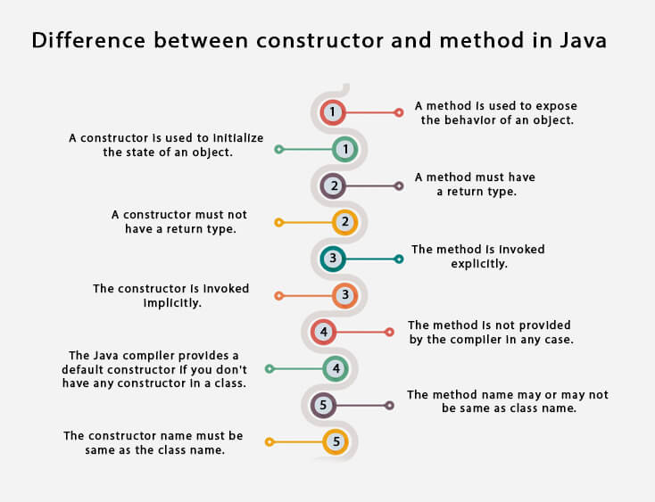
Constructors
Rules for creating Java constructor
Constructor name must be the same as its class name
A Constructor must have no explicit return type
A Java constructor cannot be abstract, static, final, and synchronized

Slide 24
Anonymous object
Anonymous simply means nameless. An object which has no reference is known as an anonymous object. It can be used at the time of object creation only.
If you have to use an object only once, an anonymous object is a good approach.
Syntax:
new Calculation();//anonymous object
Calling method through a reference:
Calculation c=new Calculation();
c.fact(5);
Calling method through an anonymous object
new Calculation().fact(5);
Example: Calculation.java

Slide 25
Multiple object
Create two objects of same class
Rectangle r1=new Rectangle(), r2=new Rectangle();//creating two objects of class Rectangle
Array of objects
Unlike traditional array which store values like string, integer, Boolean, etc. array of objects stores objects. The array elements store the location of reference variables of the object
Syntax:
Class obj[]= new Class[array_length]
Example: ObjectArray.java

Slide 26
Encapsulation
Encapsulation in Java is a process of wrapping code and data together into a single unit, for example, a capsule which is mixed of several medicines.
In encapsulation, the variables of a class will be hidden from other classes, and can be accessed only through the methods of their current class. Therefore, it is also known as data hiding.
To achieve encapsulation in Java :
Declare the variables of a class as private.
Provide public setter and getter methods to modify and view the variables values.
Syntax for setter methods:
It should be public in nature.
The return-type should be void.
The setter method should be prefixed with set.
It should take some argument i.e. it should not be no-arg method.

Slide 27
Encapsulation
Syntax for getter methods:
It should be public in nature.
The return-type should not be void i.e. according to our requirement we have to give return-type.
The getter method should be prefixed with get.
It should not take any argument.
Advantage of Encapsulation
By providing only a setter or getter method, you can make the class read-only or write-only.
It provides you the control over the data. Suppose you want to set the value of id which should be greater than 100 only, you can write the logic inside the setter method.
It is a way to achieve data hiding in Java because other class will not be able to access the data through the private data members.
The encapsulate class is easy to test. So, it is better for unit testing.
The standard IDE's are providing the facility to generate the getters and setters. So, it is easy and fast to create an encapsulated class in Java.
Example: TestEncapsulation.java

Slide 28
Static Keyword
To create a static member(block, variable, method, nested class), precede its declaration with the keyword static. When a member is declared static, it can be accessed before any objects of its class are created, and without reference to any object.
The static keyword in Java is used for memory management mainly. It belongs to the class than an instance of the class.
Static Block
Static block is used for initializing the static variables. This block gets executed when the class is loaded in the memory. A class can have multiple Static blocks, which will execute in the same sequence in which they have been written into the program. Example: StaticBlock.java
Static Variables
A static variable is common to all the instances (or objects) of the class because it is a class level variable. In other words you can say that only a single copy of static variable is created and shared among all the instances of the class. Memory allocation for such variables only happens once when the class is loaded in the memory. Example: StaticVariable1.java, StaticVariable2.java

Slide 29
Static Keyword
Java Static Methods
Static Methods can access class variables(static variables) without using object(instance) of the class, however non-static methods and non-static variables can only be accessed using objects.
Restrictions:
They can only call other static methods
They can only access static data
They cannot refer to this or super in any way.
Example: StaticMethod.java
Static Class
A class can be made static only if it is a nested class.
Nested static class doesn’t need reference of Outer class
A static class cannot access non-static members of the Outer class

Slide 30
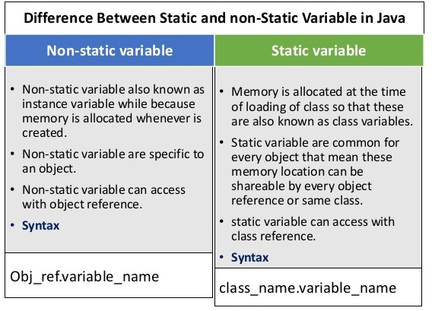
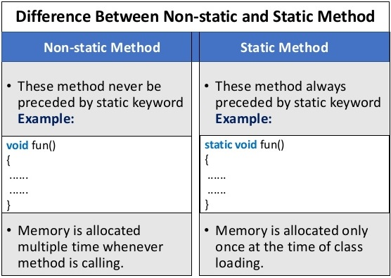
Static Vs Non-static

Slide 31
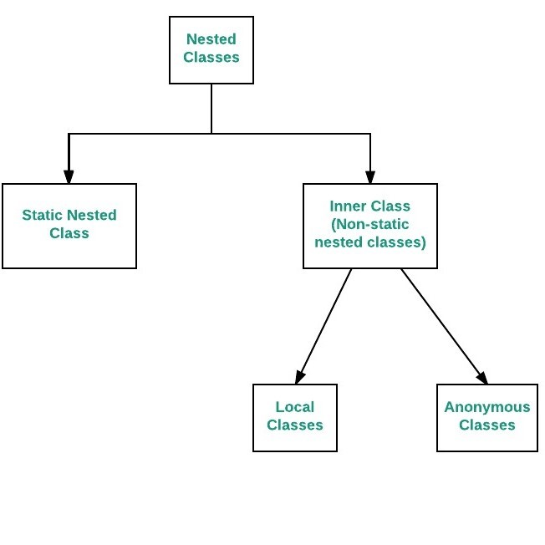
Nested Classes
To define a class within another class, such classes are known as nested classes. They enable you to logically group classes that are only used in one place, thus this increases the use of encapsulation, and create more readable and maintainable code.
The scope of a nested class is bounded by the scope of its enclosing class.
A nested class has access to the members, including private members, of the class in which it is nested. However, reverse is not true i.e. the enclosing class does not have access to the members of the nested class.
A nested class is also a member of its enclosing class.
Syntax:
class OuterClass
{ ...
class NestedClass
{ ...
}
}

Slide 32
Nested Classes: Inner class
To instantiate an inner class, you must first instantiate the outer class.
Then, create the inner object within the outer object with this syntax: - OuterClass.InnerClass innerObject = outerObject.new InnerClass();
Example: InnerClassDemo.java
Static nested class
A static class i.e. created inside a class is called static nested class in java. It cannot access non-static data members and methods. It can be accessed by outer class name.
It can access static data members of outer class including private.
Static nested class cannot access non-static (instance) data member or method.
For example, to create an object for the static nested class, use this syntax:
OuterClass.StaticNestedClass nestedObject = new OuterClass.StaticNestedClass();
Example: StaticNestedClassDemo.java

